Slide 1

Gradient descent
Iterative optimization
Main reference: J. Watt et al., “Machine Learning refined”, Cambridge University Press

Slide 2
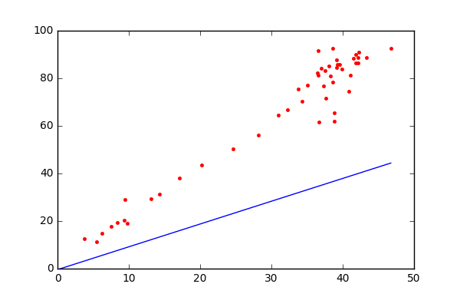
What is wrong with OLS?
Nothing! Gradient Descent is more general in that it can apply to any optimization problem by an iterative process
The gradient descent algorithm is a local optimization method where - at each step - we employ the negative gradient as our descent direction
linear regression
We start with a random parameter vector
At each step, we obtain a new parameter vector
From https://muthu.co/linear-regression-using-gradient-descent-algorithm/

Slide 3
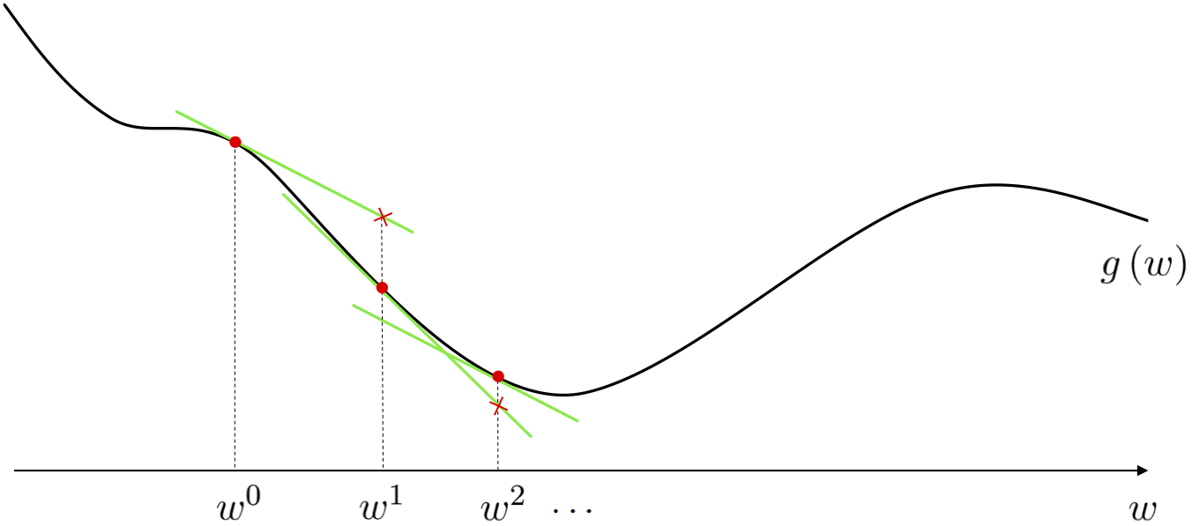
A figurative drawing
Let’s consider a cost function , for example the mean squared cost
The negative gradient of the function provides an excellent and easily computed descent direction at each step of this local optimization method

Slide 4
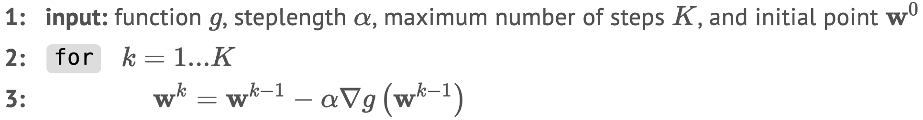
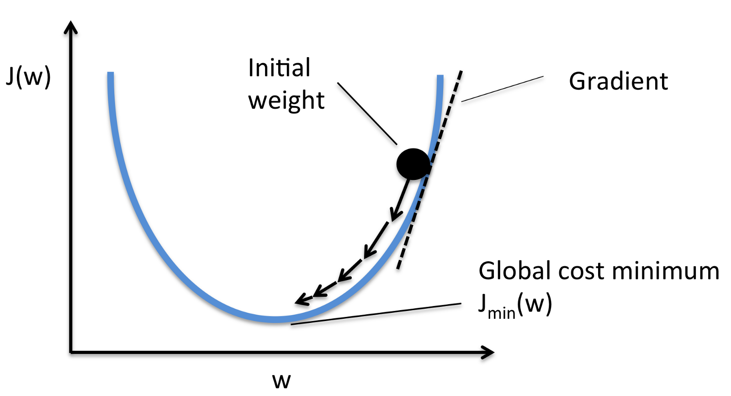
Iterative algorithm
Let’s consider a cost function , for example the mean squared cost
with
Figure taken from here

Slide 5
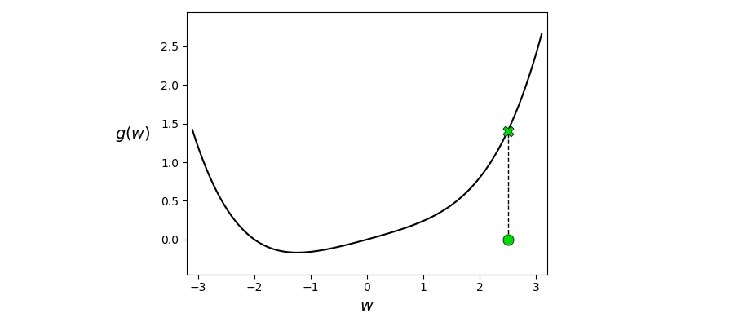
Animated illustration

Slide 6
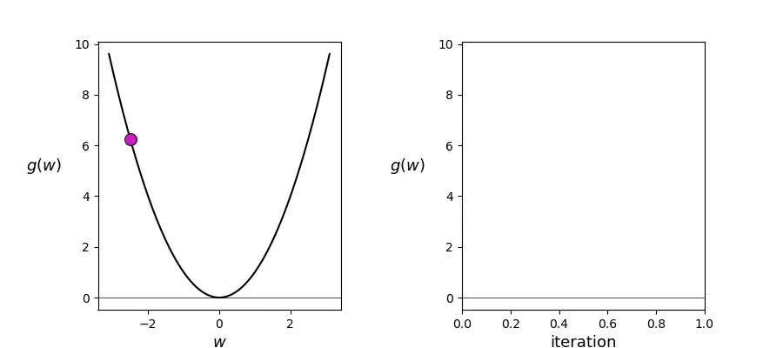
Choice of steplength ⍺ (aka learning rate)

Slide 7
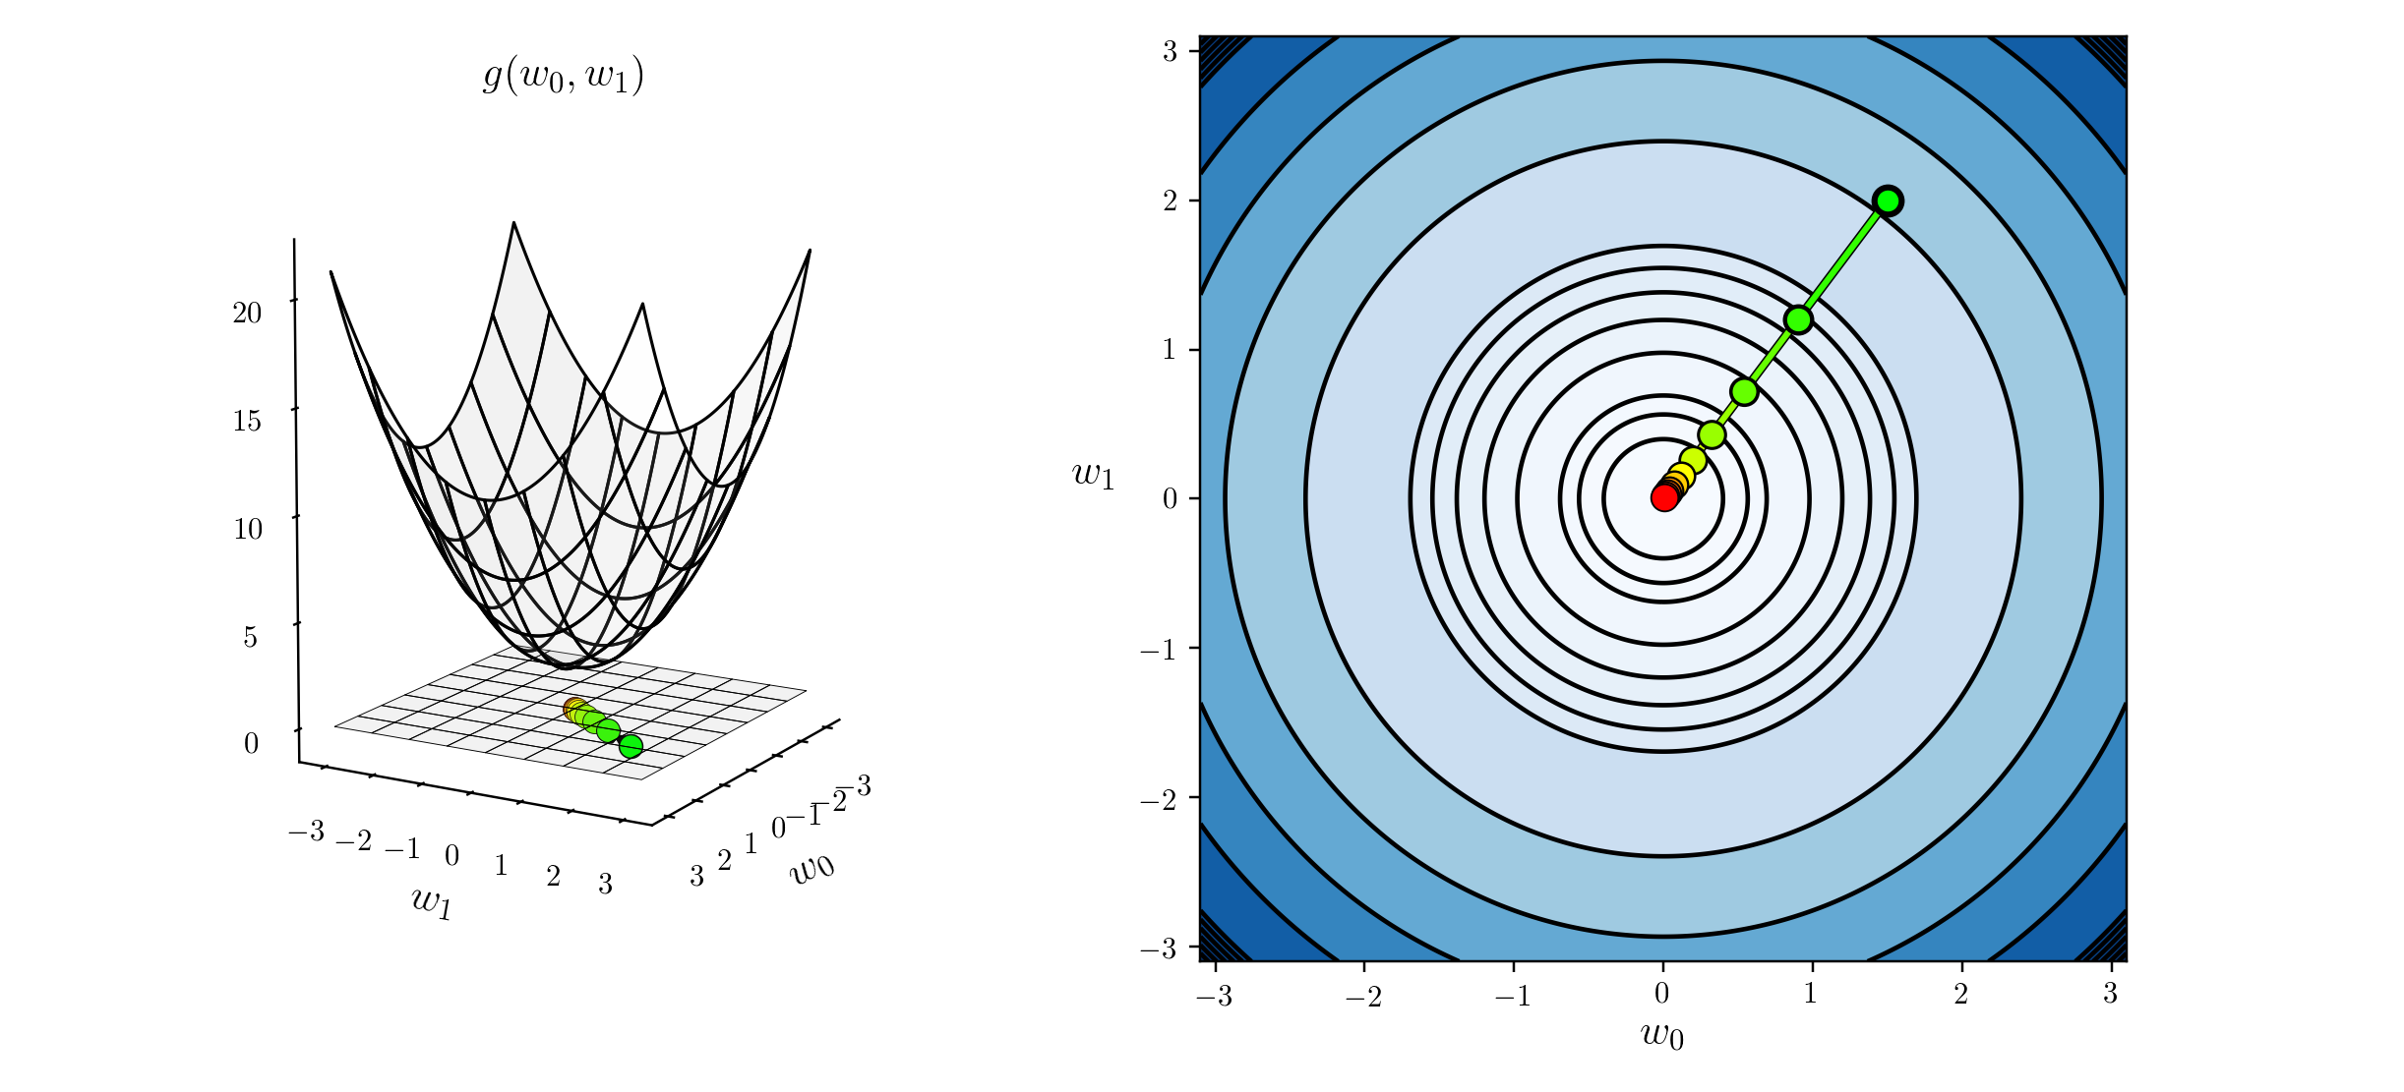
Example #1: 2 variables, quadratic cost
Let’s consider →

Slide 8
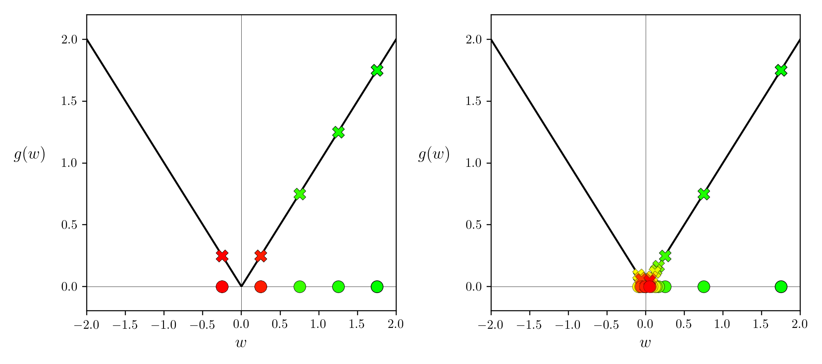
Example #2: 1 variable, absolute cost
Let’s consider →
Fixed ⍺
⍺ decreases with k

Slide 9
Example #2: 1 variable, absolute cost
Let’s consider →
Fixed ⍺
⍺ decreases with k

Slide 10
Common cost functions and their gradient
Mean squared cost function:
Mean absolute cost function:
Notes:
Chain rule: Théorème de dérivation des fonctions composées

Slide 11
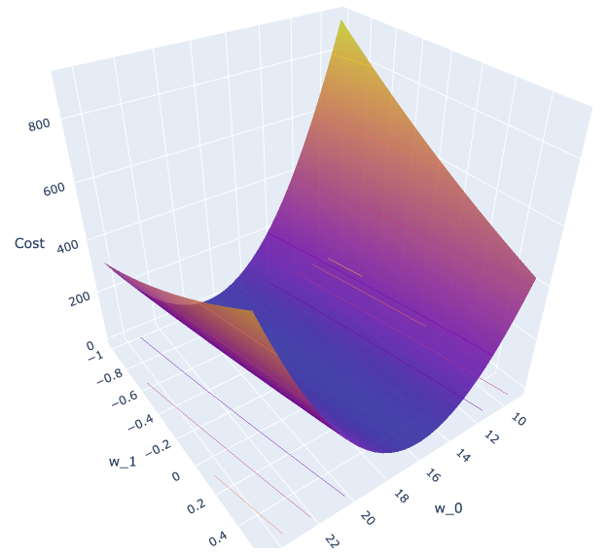
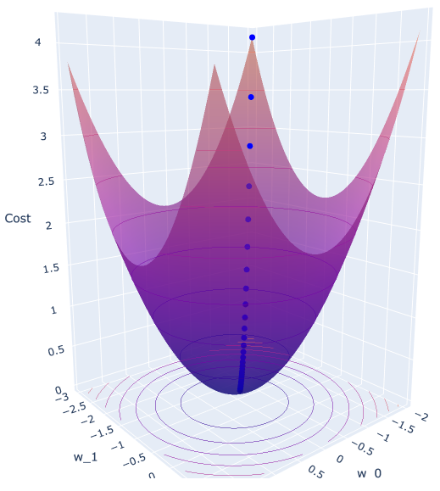
Standardizing / rescaling input variables
Rescaling all (in)dependent variables help with convergence
A common method is to scale the data to have 0 mean and unit variance
So,
Example:
  Biking / heart disease
  Mean squared cost
without standardization
with standardization

Slide 12
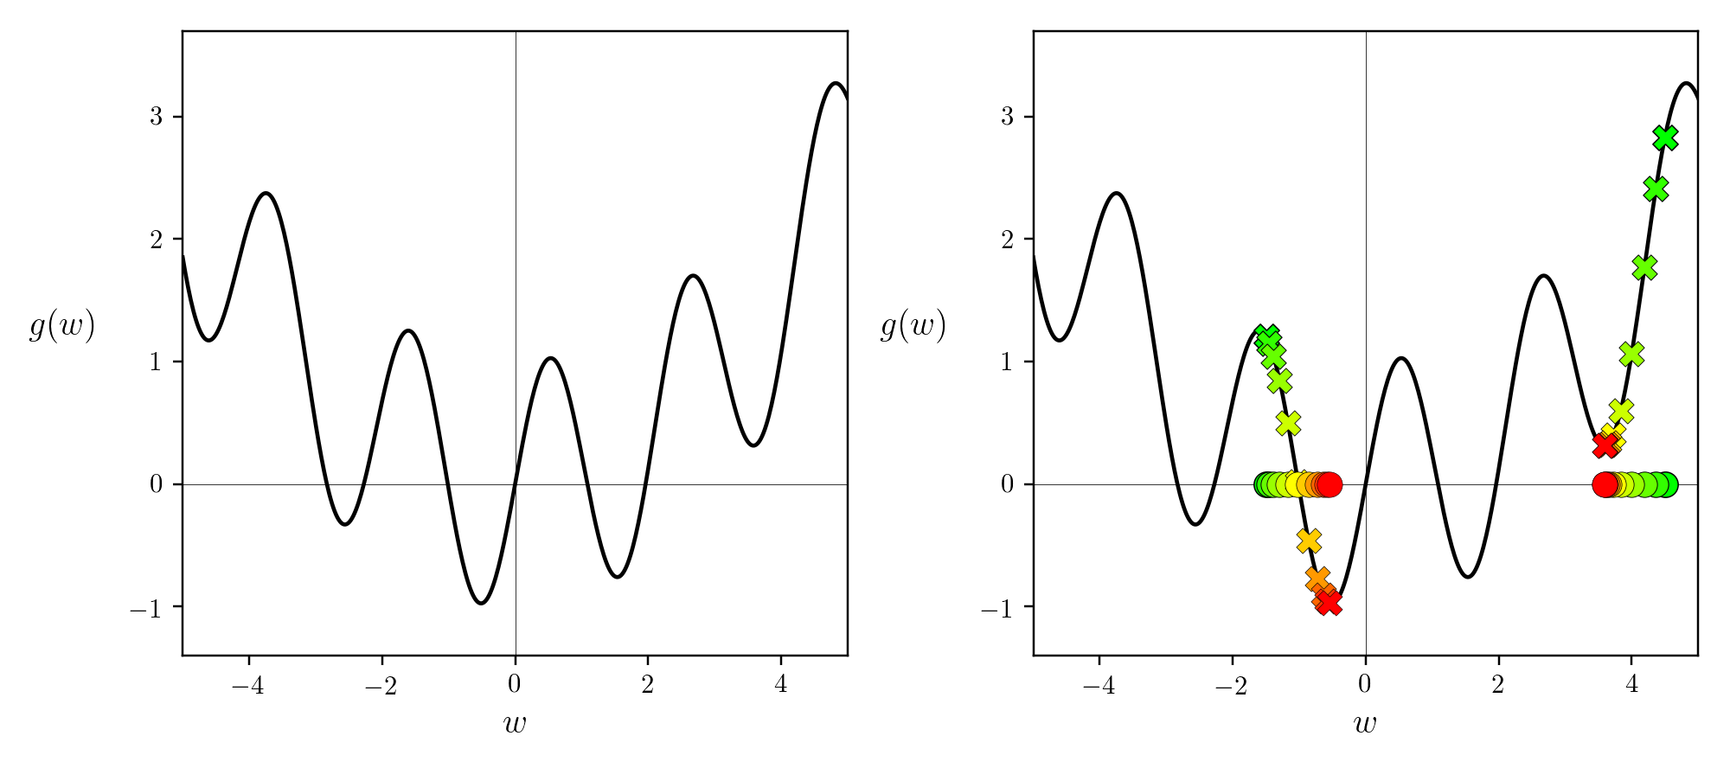
Non-convex cost functions
In theory for the most general non-convex functions, in order to find the global minimum of a function using gradient descent one may need to run it several times with different initializations and/or steplengths

Slide 13
What did I learn?
Gradient descent is an iterative optimization algorithm
Used to approximate the local minima of a differentiable (cost) function
Single local minimum of a convex (cost) function; i.e., global minimum
Two common convex cost functions: (mean) squared and (mean) absolute
scikit-learn proposes SGDregressor() – the gradient of the cost (loss) is estimated each sample at a time and the model is updated along the way with a decreasing steplength (aka learning rate) – cf. notebook

Slide 14

QUESTIONS ?

